Slide 1

Exploring Microsoft Office
Excel 2010
by Robert Grauer, Keith Mulbery, and Mary Anne Poatsy
Chapter 1 - 3
Introduction to Excel
Notes:
This chapter introduces you to Excel and the use of the spreadsheet.

Slide 2
Introduction to Spreadsheets
A spreadsheet is an electronic file used to organize related data and perform calculations
If data is altered, formulas automatically recalculate results
Notes:
A spreadsheet is an electronic file that contains a grid of columns and rows used to organize related data and perform calculations. Excel is a spreadsheet program used to create and modify electronic spreadsheets.
Before the existence of spreadsheet programs like Excel, people handwrote figures in paper ledgers to track quantitative data.
An electronic spreadsheet makes data-entry changes easy, and if the formulas are correctly constructed, the results recalculate automatically and accurately.

Slide 3
Exploring the Excel Window
Worksheet rows lie horizontally
Worksheet columns lie vertically
A cell is the intersection of a row and column
A cell address or cell reference names a cell
Notes:
Worksheet rows lie horizontally and are numbered from 1 to 1048576. Worksheet columns lie vertically and are labeled from A to Z. Successive groups of 26 columns are labeled AA to AZ, BA to BZ, etc.
A cell is the intersection of a row and column. Each cell has a cell address made up from the column letter and row number.
For example, the cell address of the top left cell is A1.

Slide 4
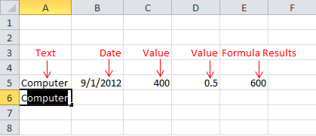
Entering and Editing Cell Data
Excel supports text, values, dates, and formula results
Notes:
The four types of data that you can enter in a cell include text, values or numbers, dates, and formulas. See Figure 1.4 for a display of each type of data.

Slide 5
Entering Formulas
Formulas are combinations of cell addresses, math operators, values and/or functions
A formula begins with the equal sign =
Examples:
=A1+A2
=C2*5
Notes:
Formulas are combinations of cell addresses, math operators, values and/or functions. A function is a built-in formula, including SUM and AVERAGE functions.
Excel designates a formula with a preceding equal sign, =. One example of formula is =A1+A2 which adds the values in cells A1 and A2 and displays the sum. A second example of a formula is =C2*5 which multiplies the value in cell C2 by 5 and displays the product.

Slide 6
Entering Formulas
Cell D4 contains formula =B4*C4
Cell C8 contains formula =C4+C5+C6+C7
Notes:
When formulas are entered in a worksheet, the result appears in the cell. The formula itself is displayed in the Formula Bar when the cell is selected.

Slide 7
Cell References in Formulas
It is best to use cell addresses in formulas versus actual data
If cell A1 contains value 5 and you need to add B1 to this value, use =A1+B1 versus =5+B1
If the data changes, Excel will recalculate the result
Notes:
It is best to use cell addresses in formulas rather than actual data. For example, if cell A1 contains the value 5, and you need to add B1 to this value, use =A1+B1 versus =5+B1
Remember, if the data changes, you want Excel to recalculate the answer.

Slide 8
Displaying Cell Formulas
The result of a formula appears in a cell and the formula itself appears in the Formula bar
Press the Ctrl+` key combination to display formulas in the worksheet
This key combination acts as a toggle so can be used again to turn off the effect
Notes:
The result of a formula appears in a cell. The formula itself appears in the Formula bar. Press the Ctrl+` key combination to display formulas in the worksheet. This key combination acts as a toggle, so you can use it again to turn off the effect. You can also click Show Formulas in the Formula Auditing group on the Formulas tab.

Slide 9
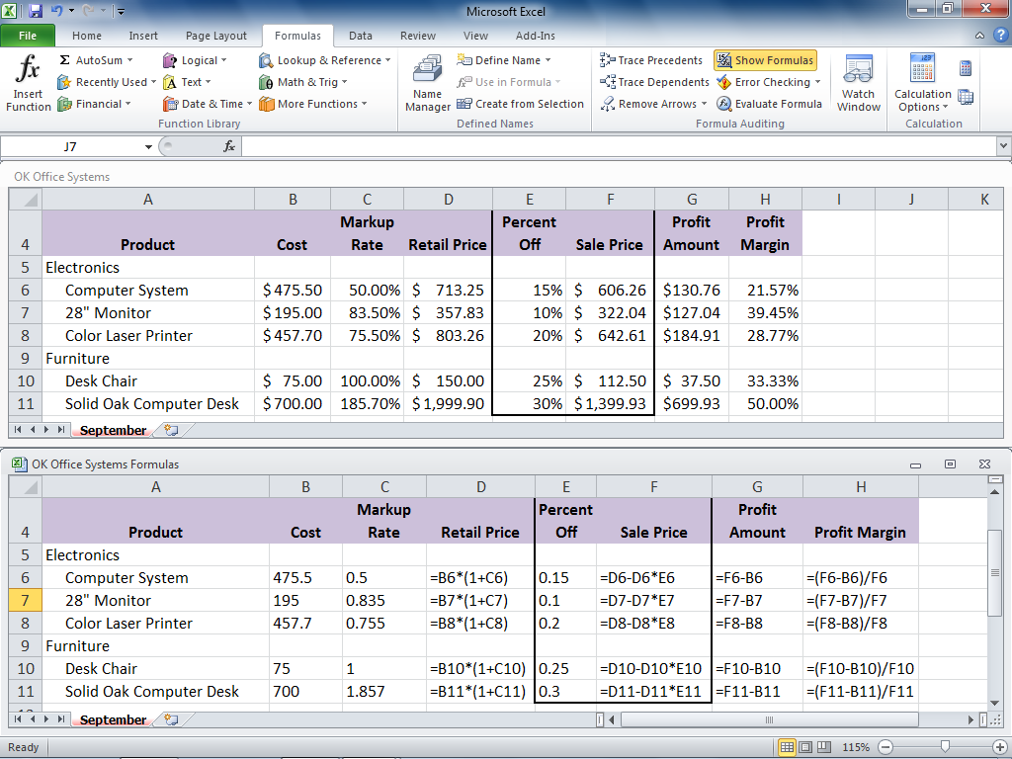
Displaying Cell Formulas
Notes:
See Figure 1.11 for an illustration of a Cell Formula display.

Slide 10
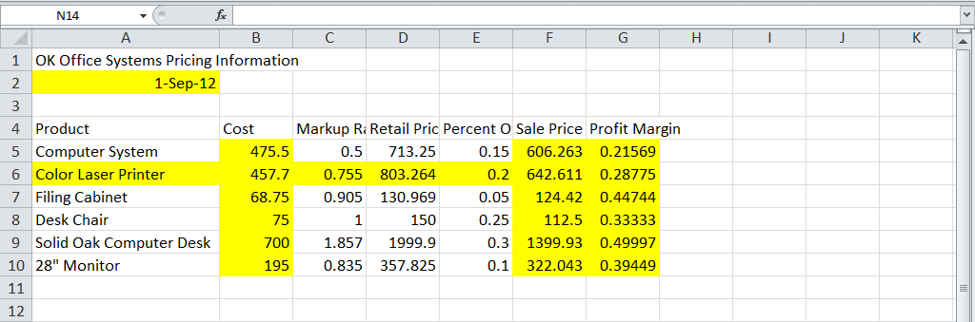
Selecting a Cell Range
A range is a rectangular group of cells
A nonadjacent range contains a group of ranges that are not next to each other
Notes:
A range is a rectangular group of cells. The easiest way to select a range is to drag from the upper left cell to the lower right cell.
A nonadjacent range contains a group of ranges that are not next to each other. To create a nonadjacent range, select the first range, hold down the Ctrl key, and select the second range. Continue holding the Ctrl key to add more ranges to the group.
A range is selected to perform group formatting or to manipulate the group of cells as a unit with respect to moving, copying, or deletion.

Slide 11
Moving/Copying a Range
Moving/copying a range preserves text and values, but cell addresses in formulas will be altered in the pasted location
Move a range by cutting it and pasting to the upper left corner of the destination
Copy a range can by copying it and pasting to the upper left corner of the destination
Notes:
Moving/copying a range preserves text and values, but cell addresses in formulas, such as cell reference A1, will be altered in the pasted location. Move a range by cutting it and pasting to the upper left cell of the new location. The shortcut key combination for cutting is Ctrl+X and pasting is Ctrl+V. Copy a range by copying it and pasting to the upper left cell of the new location. The shortcut key combination for copying is Ctrl+C.

Slide 12
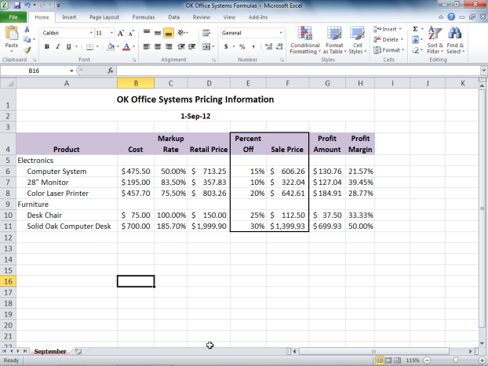
Formatting
Formatting accentuates and draws attention to meaningful portions of a worksheet
Notes:
Formatting accentuates and draws attention to meaningful portions of a worksheet. Horizontal alignment positions data between the left and right cell margins. Vertical alignment positions data between the top and bottom cell margins. The Merge and Center command is used to center a title over a range of columns.
To offset labels, text can be indented within a cell. You can use text wrapping to make data appear to lie on multiple lines without inserting a manual break with Alt-Enter. A border is a line that surrounds a cell or range. And Fill color is the background color of a cell or range.

Slide 13
Numeric Formats
Format Style | Display
General | A number as it was originally entered.
Number | A number with or without the 1,000 separator
Currency | A number with the 1,000 separator and with an optional dollar sign to the immediate left.
Accounting | A number with the 1,000 separator and with an optional dollar sign at the left cell border.
Date | The date in different ways, such as March 14, 2012 or 3/14/12.
Time | The time in different ways, such as 10:50 PM or 22:50 (24-hour time).
Notes:
See Table 1.6 for common numeric formats such as General, Number, Currency, Accounting, Date, and Time. Many numeric formats permit the user to specify the number of decimal places and options for negative values including parentheses and/or red color.

Slide 14
Numeric Formats (continued)
Format Style | Display
Percentage | A value as it would be multiplied by 100 with the percent sign.
Fraction | A number as a fraction; appropriate when there is no exact decimal equivalent.
Scientific | A number as a decimal fraction followed by a whole number exponent of 10.
Text | The data left-aligned; is useful for numerical values that have leading zeros and should be treated as text.
Special | A number with editing characters, such as hyphens.
Custom | Predefined customized number formats or special symbols to create your own format.
Notes:
Additional numeric formats include Percentage, Fraction, Scientific, Text, and Special. It is also possible to create your own Custom format. Many numeric formats permit the user to specify the number of decimal places and options for negative values.

Slide 15
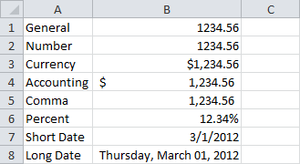
Numeric Formats (continued)
Notes:
Figure 1.36 illustrates several numeric formats as they appear on a worksheet.

Slide 16
Cell References
Excel offers three types of cell references for use when a formula is copied
Absolute $A$1
Relative A1
Mixed $A1 or A$1
$ indicates that the row number or column letter will not be modified during a copy
Notes:
Excel offers three types of cell references for use when a formula is copied. An absolute cell reference (for example, $A$1) indicates that the address will be fixed and will not be altered during a copy operation. A relative reference (for example, A1) indicates that the address will be adjusted relative to its new location. A mixed reference (for example, $A1 or A$1) has one part that is absolute and the other relative.
The F4 key can be used to toggle through the four types of cell references.

Slide 17
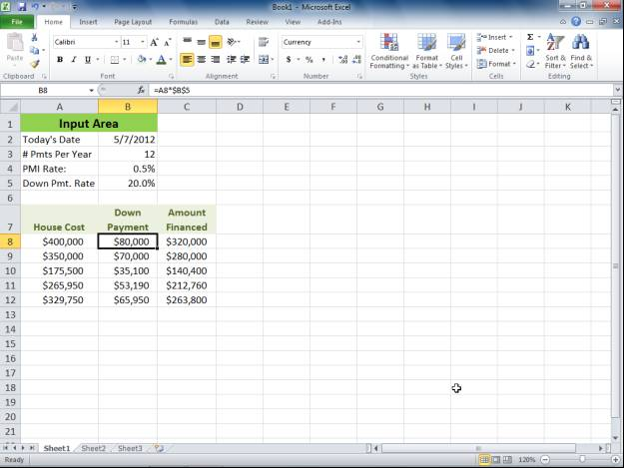
Relative Cell References
When the formula shown in the formula bar is copied, relative address A8 is modified
Notes:
Figure 2.1 in the textbook illustrates formulas using relative cell references. The house cost in column A differs for each row and should be altered during a copy operation. So, for example, when the formula =A8*$B$5 is copied from row 8 to row 9, the formula become =A9*$B$5

Slide 18
Absolute Cell References
When the formula shown in the formula bar is copied, absolute address $B$5 is fixed
Notes:
Again, in Figure 2.1, the textbook illustrates a formula with an absolute cell reference. The down payment rate in cell B5 is the same for each row and should not be altered during a copy operation. For example, when the formula =A8*$B$5 is copied from row 8 to row 9, the formula become =A9*$B$5

Slide 19
Mixed Cell References
In mixed reference $A1, the column is fixed, but the row may be altered during a copy
In mixed reference A$1, the row is fixed, but the column may be altered during a copy
Notes:
A mixed cell reference contains a fixed column and relative row or a fixed row and a relative column.

Slide 20
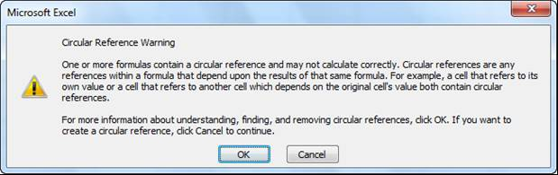
Avoiding Circular References
A circular reference error occurs if a formula refers to itself
Notes:
A circular reference would occur if the formula written in cell C8 is =A8-C8. Since the formula is self-referential and cannot be evaluated, the error message in Figure 2.2 will appear. Excel displays a green triangle in the top-left corner of a cell if it detects a potential error in a formula.

Slide 21
Function Basics
An Excel function is a predefined formula that performs a calculation
Category | Description
Compatibility | Contains functions compatible with Excel 2007 and earlier.
Cube | Returns values based on data in a cube, such as validating membership or returning a member’s ranking.
Database | Analyzes records stored in a database format in Excel and returns key values, such as the number of records or averages value in a field.
Date & Time | Provides methods for manipulating date and time values.
Notes:
An Excel function is a predefined formula available in many categories. Function categories and their descriptions are listed in Table 2.1. Some categories include Compatibility, Cube, Database, and Date & Time.

Slide 22
Function Basics (continued)
Category | Description
Engineering | Calculates values commonly used by engineers, such as conversions.
Financial | Performs financial calculations, such as payments, rates and present/future values.
Information | Provides information about the contents of a cell, typically displaying TRUE if the cell contains a particular data type, such as a value.
Logical | Performs logical tests and returns the value of the tests. Includes logical operators such as AND, OR, and NOT.
Lookup & Reference | Looks up values, creates links to cells, or provides references to cells in a worksheet.
Math & Trig | Performs standard math and trigonometry calculations.
Statistical | Performs statistical calculations, such as averages or standard deviation.
Text | Manipulates text strings, by combining words or converting cases.
Notes:
Additional function categories shown in Table 2.1 include Engineering, Financial, Information, Logical, Lookup, Math & Trig, Statistical and Text.

Slide 23
Function Terminology
Syntax is the set of rules that govern correct formation of a function
An argument is an input, such as a cell or range
A function begins with the equal sign (=) followed by the function name and arguments in parentheses
Example: =SUM(A1:A3)
Notes:
The function =SUM(A1:A3) exhibits correct syntax and is well-formed. The function begins with an equal sign (=), then lists the function name (SUM). The argument or input to this function is a range of cells (A1:A3). This function returns the mathematical sum of values in the range A1 to A3.

Slide 24
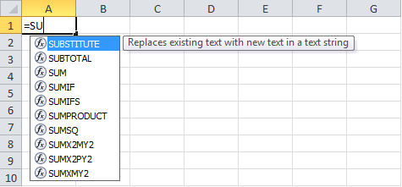
Inserting a Function
When a function is typed, Formula AutoComplete displays a list of functions matching the partial entry
Notes:
Excel offers several techniques with which to enter a function. As you type, the Formula AutoComplete option lists all of the names that match the partial entry. In Figure 2.8, a list of functions beginning with letters =SU appears.

Slide 25

Inserting a Function
A function ScreenTip is a small pop-up description that displays the function arguments
Notes:
A function ScreenTip will appear with each function argument boldfaced. In Figure 2.9, the argument number of the SUM function is boldfaced indicating that a number, cell address, or range is expected.

Slide 26
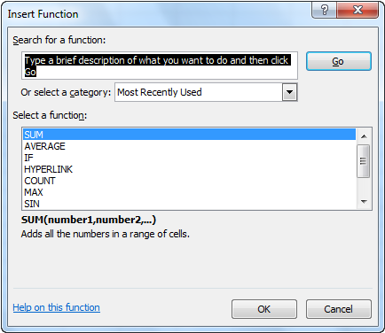
Insert Function Dialog Box
Use the Insert Function dialog box to search for a function or select one from a list
Notes:
The Insert Function dialog box can be used to search for a function for which you do not know the name or to select one from a category list. Figure 2.10 illustrates use of the Insert Function dialog box.

Slide 27
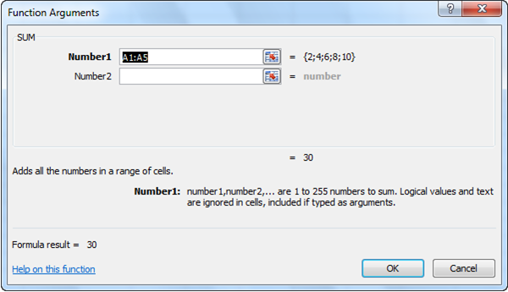
Function Arguments Dialog Box
The Function Arguments dialog box offers help on each argument
Notes:
Once a function is selected, the Function Arguments dialog box opens with information on each argument syntax. Figure 2.11 illustrates the Function Arguments dialog box.

Slide 28
Totaling Values with SUM
The SUM function returns the mathematical sum of some number of cells or ranges; for example:
=SUM(A1:A3)
=SUM(A1,B3,C5)
=SUM(A1:B3,C5:E8)
Notes:
The SUM function returns the mathematical sum of some number of cells or ranges. Multiple cells or ranges are separated by a comma (,). Examples include:
=SUM(A1:A3), which returns the sum of values in the range A1 to A3
=SUM(A1,B3,C5), which returns the sum of values in the three cells A1, B3, and C5
=SUM(A1:B3,C5:E8), which returns the sum of values in the range A1 to B3 and C5 to E8
Do not use a formula as an argument in this case. For example, =SUM(A1+A2) computes the addition of A1 and A2, and then returns the sum of that one value. It is a misuse of the SUM function.

Slide 29
Basic Statistical Functions
Common statistical functions include:
AVERAGE arithmetic mean
MEDIAN midpoint value
MIN minimum value
MAX maximum value
COUNT number of values in range
COUNTA number of nonempty cells
COUNTBLANK number of empty cells
Notes:
Common statistical functions include the following:
AVERAGE returns the average or arithmetic mean of a range.
MEDIAN returns the midpoint value, halfway between the lowest and highest value in a range.
MIN returns the smallest or minimum value in a range.
MAX returns the largest or maximum value in a range.
COUNT returns the number of numeric values in a range.
COUNTA returns the number of nonempty cells in a range.
COUNTBLANK returns the number of empty cells in a range.

Slide 30
Date Functions
Since dates are numeric, calculations can be performed, such as subtraction
The TODAY function displays the current date
The NOW function displays the current date and time
Notes:
Since dates are numeric, calculations can be performed, such as subtraction. This is useful, for example, to compute the number of days that have passed between two dates. The =TODAY( ) function displays the current date. Although the function has no arguments, empty parentheses are required. The =NOW( ) function displays the current date and time.

Slide 31
Making Decisions with the IF Function
=IF(logical_test, value_if_true,value_if_false)
The IF function has three arguments:
A logical test or condition that is true or false
The resulting value if the condition is true
The resulting value if the condition is false
Notes:
The IF function enables a worksheet to display different results depending on a logical condition. For example, the IF function could be used to evaluate whether an employee has met a sales quota and display a bonus of either $500 or $0. The IF function has three arguments including the logical test, result if the condition is true, and result if the condition is false.

Slide 32
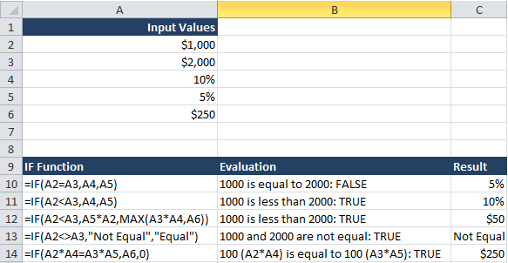
Using the IF Function
Notes:
Figure 2.18 illustrates several examples of IF functions and their results.

Slide 33
Using Lookup Functions
Lookup functions are used to look up values in a table to perform calculations or display results
For example, a teacher may want to look up an average in order to assign a grade
Range | Grade
90-100 | A
80-89 | B
70-79 | C
60-69 | D
Below 60 | F
Notes:
Excel offers a number of Lookup functions in which a table is searched for a value and corresponding data is returned. In the grading scale table shown in Table 2.4, the teacher might look up an average of 75 and determine that the matching grade is C.

Slide 34
Creating a Lookup Table
When searching a range, the breakpoint is the lowest value
A lookup table typically lists breakpoints in one column and return values in a second column
Range | Grade
0 | F
60 | D
70 | C
80 | B
90 | A
Notes:
The lookup table shown in Table 2.5 lists the breakpoints for the grade ranges in the first column. Each breakpoint is the low end of the range; for example, in the range 90-100, value 90 is the breakpoint. Breakpoints are listed in ascending order.
The second column of the table lists the result or the value associated with each range.

Slide 35
VLOOKUP Function
The VLOOKUP function searches a lookup table for a value and returns the result from the related column
VLOOKUP has three required arguments:
Lookup value
Table array (range of lookup table)
Column index of return value
Notes:
The VLOOKUP function is passed a value to look up, the range of the lookup table, and the column number containing the return value. For example, =VLOOKUP(A1,$B$4:$C$8,2) requests that value A1 be looked up in the table extending from B4 through C8.
The function then returns the corresponding value in the second column. If there is not an exact match with the value in the first column, Excel uses the row before the first breakpoint that is larger than the value.

Slide 36
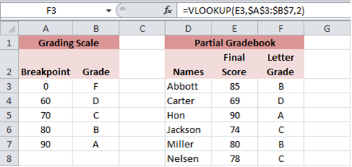
Using the VLOOKUP Function
Notes:
Figure 2.19 illustrates the VLOOKUP function in cell F3 to be used to compute grades. The grade to be looked up is E3. This is a relative cell reference, so it can be altered when the formula is copied to successive rows. The table array uses range $A$3:$B$7. It uses an absolute range, so it is not altered when the formula is copied. The column index is 2, requesting that the function return value is to be obtained from the second column of the table.

Slide 37
HLOOKUP Function
The HLOOKUP function is used when the breakpoints and return data are placed in rows
The third argument now lists the row index
0 | 60 | 70 | 80 | 90
F | D | C | B | A
Notes:
Table 2.6 illustrates a lookup table for the HLOOKUP function.

Slide 38
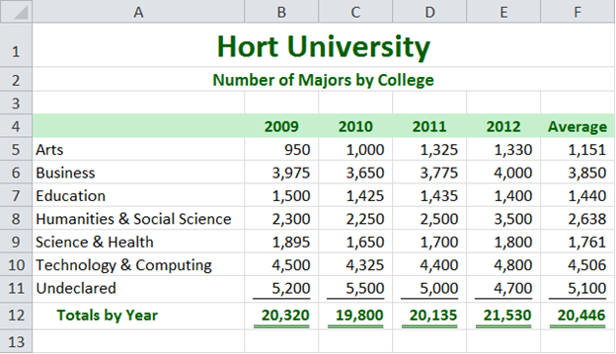
Chart Basics
A chart is a visual representation of numeric data
Notes:
An effective chart depicts data in a clear, easy-to-interpret fashion. It is a visual representation of numerical data that compares data and helps to reveal trends or patterns. Figure 3.1 illustrates the number of majors by college and year for a university. Notice how the data is arranged in rows and columns.

Slide 39
Chart Basics
Chart components include:
Data Points
Data Series
Category Labels
Notes:
A data point is one numeric value on the worksheet that describes a single value on a chart. In Figure 3.1 on the previous slide, cell E5 could be a data point, representing the number of majors in the Art college in 2012.
A data series is a group of related data points. In Figure 3.1, the range E5:E11 could be a data series, representing the number of majors across all colleges in 2012.
A category label is text describing a data point or other collection of data. In Figure 3.1, cell A5 with the text “Arts” could represent a category label as it describes the data point E5.

Slide 40
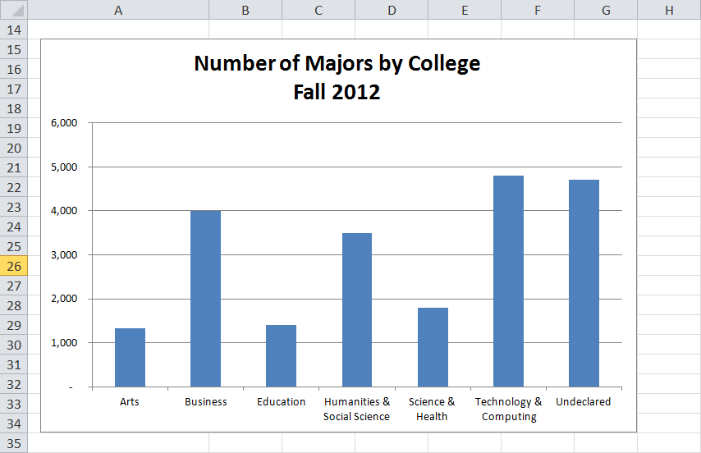
Column Charts
A column chart displays data vertically, with each data series forming a column
Notes:
Figure 3.2 illustrates a column chart, plotting the number of majors across all colleges in 2012. It plots a single data series, including values for year 2012.
The chart area contains the entire chart and all of its elements. The plot area contains the graphical representation of values in the data series. The X-axis (Category axis) is a horizontal line that borders the plot area and often displays category labels. The Y-axis (Value axis) is a vertical line that borders the plot area and contains markers to help display the values in the data series.

Slide 41
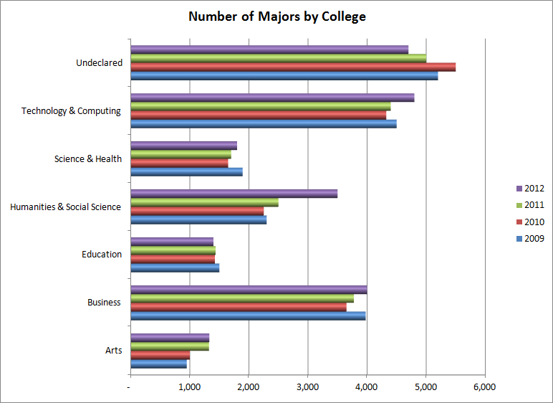
Bar Chart
Notes:
Figure 3.9 illustrates a clustered bar chart.
This type of chart compares values across categories using horizontal bars. Bar charts, like column charts, may plot single or multiple data series, appear clustered or stacked, or add a 3-D effect.

Slide 42
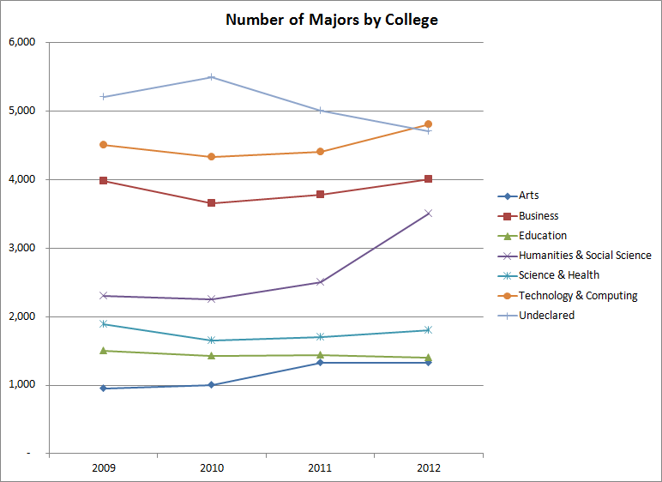
Line Chart
Notes:
Figure 3.10 illustrates a line chart.
This type of chart uses a line to connect data points in order to show trends over a period of time. The X axis (Category axis) typically displays time units, and the Y axis (Value axis) displays values for each point.

Slide 43
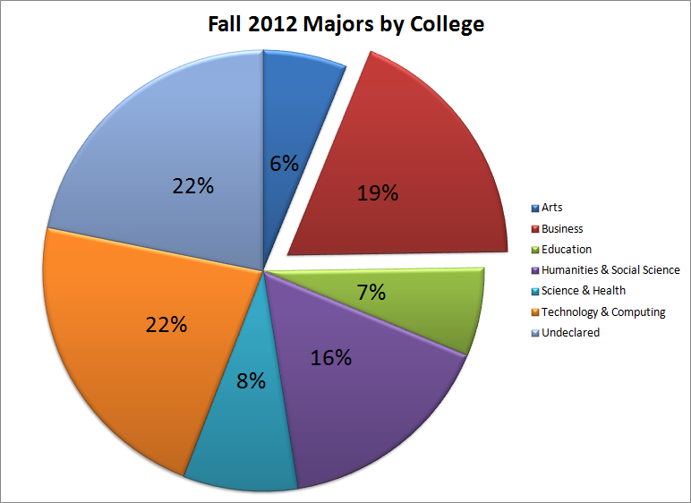
Pie Chart
Notes:
Figure 3.11 illustrates a pie chart.
This type of chart plots a single data series where each point is a sector with area proportional to the total of the series. A legend is used to display the category label for each data point in a different color. Data labels, such as percentages, are often portrayed on the pie wedges. An exploded pie chart separates one or more pie slices from the rest.

Slide 44
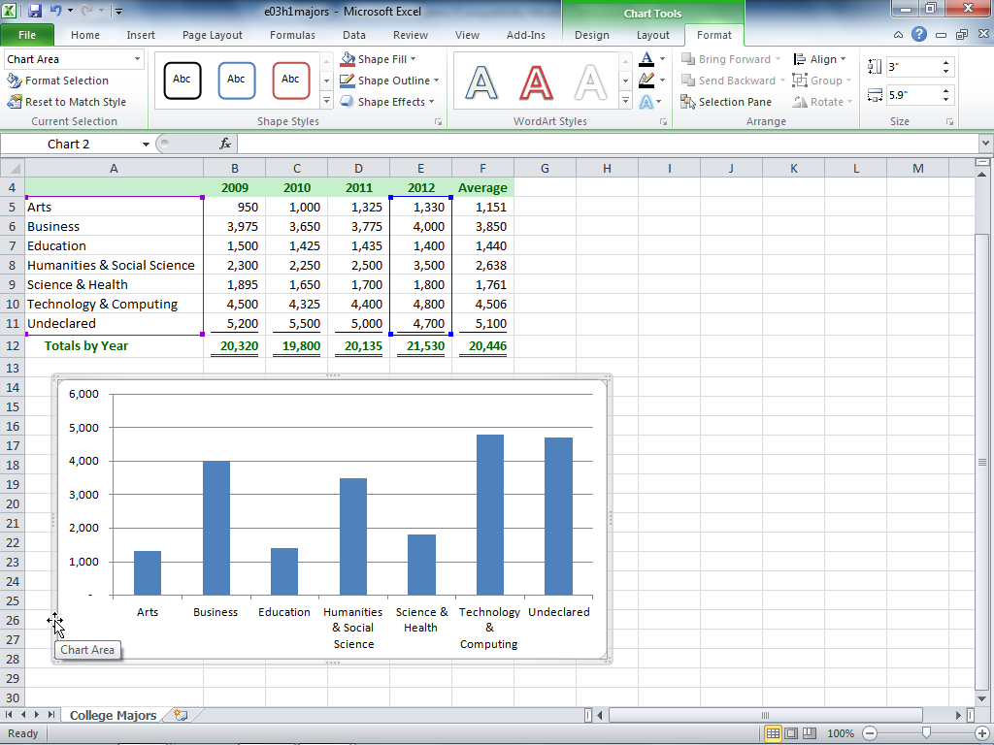
Creating a Chart
Select the data source
Select the chart type
Position and size the chart
Notes:
The data source includes the data series, category labels and series names. Use the Ctrl key to select noncontiguous ranges. To create a chart, click the Insert tab, click the chart type (such as Column) in the Chart group, and then select a subtype (such as Clustered Column) from the chart gallery. A sizing handle, indicated by faint dots on the outside border of a selected chart, enables you to adjust the size of the chart.

Slide 45
Changing the Chart Type
Using the Chart Tools contextual tab:
Click the Design tab
Click Change Chart Type
Select the desired chart type
Notes:
Once a chart is selected, Excel displays the Chart Tools contextual tab with tabs for Design, Layout, and Format. You can change the chart type by clicking the Change Chart Type button in the Type group on the Design tab.

Slide 46
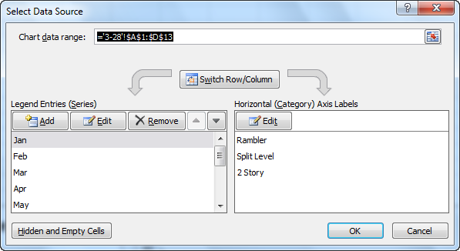
Changing the Data Source
To modify the chart data source:
Click the Design tab
Click Select Data under the Data group
Notes:
The Select Data Source dialog box illustrated in Figure 3.29 can be used to add a new data series, remove an existing one, or edit the range on an existing series.

Slide 47
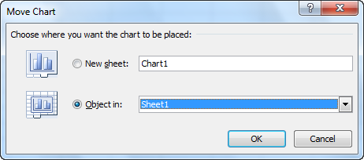
Moving a Chart
To move a chart:
Click the Design tab
Click Move Chart under the Location group
Notes:
By default, a chart is placed in the same worksheet as the data source. You can also choose to move the chart to another location. The Move Chart dialog box, shown in Figure 3.31, offers choices for the chart location to be in a different or new worksheet.

Slide 48
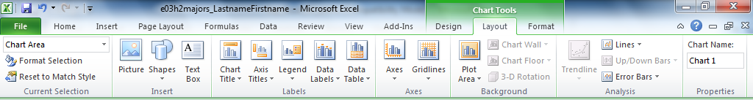
Chart Layout
The Layout tab offers many ways to enhance a chart visually
Notes:
The Layout tab offers many ways to enhance a chart visually. Care should be taken not to overpower the chart, but rather to enhance its effectiveness in portraying information. As shown in Figure 3.39, the Chart Layout Tools Tab, options include inserting objects, removing objects, customizing axes, formatting the background, and including analysis.

Slide 49
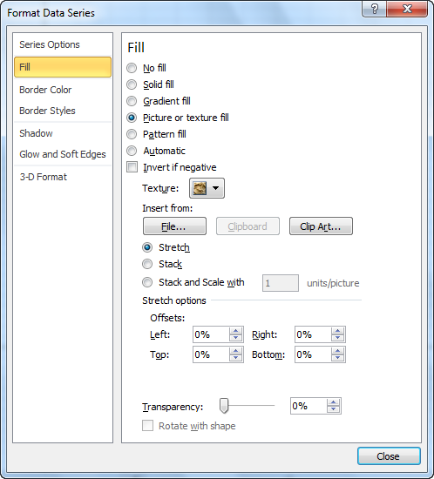
Selecting and Formatting Chart Elements
Formatting a chart element:
Right-click the element and select the Format element command
The element portion will change depending on the selection (ex. Format Data Series)
Notes:
The easiest method to format a chart element, such as a legend or data series, is to right-click it on the chart and select the Format element command. The element portion will change depending on the selection (for example, Format Data Series or Format Legend).
Figure 3.40 illustrates the Format Data Series dialog box with options for Fill, Border Color, and more. Alternatively, you can click the Chart Elements arrow in the Current Selections group, and select the element from the list. Once selected, click Format Selection in the Current Selections group.

Slide 50
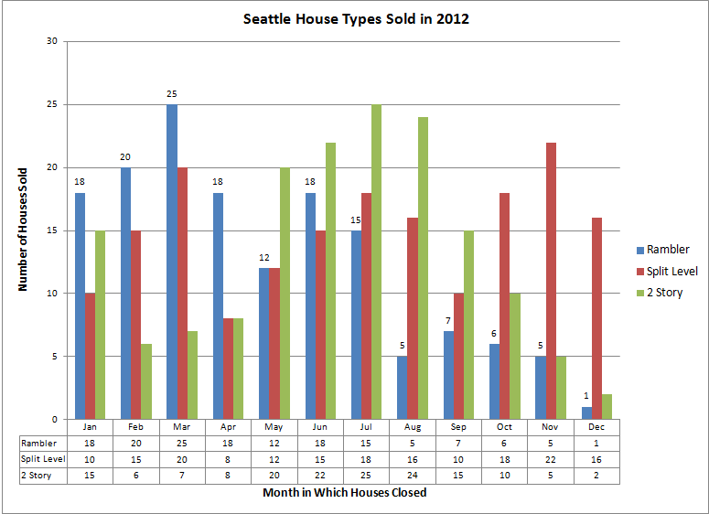
Customizing Chart Labels
Notes:
Chart labels, as shown in Figure 3.42, include:
Chart title
Data labels
Value axis title
Category axis title
Legend
Data Table

Slide 51
Chart Titles and Legend
A chart title is the label that describes the entire chart
An axis title is a label that describes either the category or value axis
A legend is used to distinguish data points in a pie chart or data series in a multiple series chart
Notes:
The Labels group on the Layout tab contains options to edit the chart title, axis titles, legend, data labels, and data table. Chart title options include None, Centered Overlay Title, and Above Chart. More Title Options offer fill, border, and alignment settings.
To display category axis title options, click Axis Titles in the Labels group, and point to Primary Horizontal Axis Title. Options include None, Title Below Axis, and More Primary Horizontal Axis Title Options. To display value axis title options, click Axis Titles in the Labels group, and point to Primary Vertical Axis Title. Options include None, Rotated Title, Vertical Title, Horizontal Title and More Primary Vertical Axis Title Options. Legend options include None and the desired location of the legend.

Slide 52
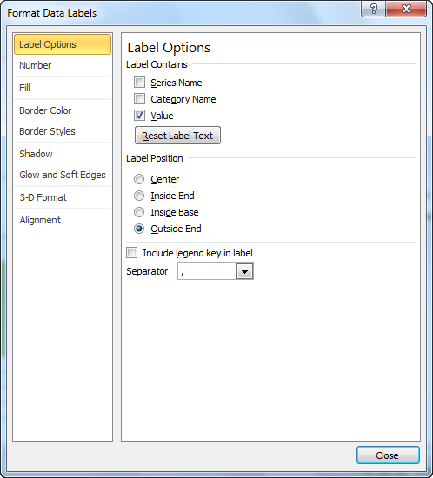
Data Labels
A data label is the value or name of a data point
Notes:
Data labels are descriptive labels that show the exact value of the data points on the value axis. Add data labels only when necessary to reduce a cluttered look to the chart.
Figure 3.43 illustrates formatting options for data labels.

Slide 53
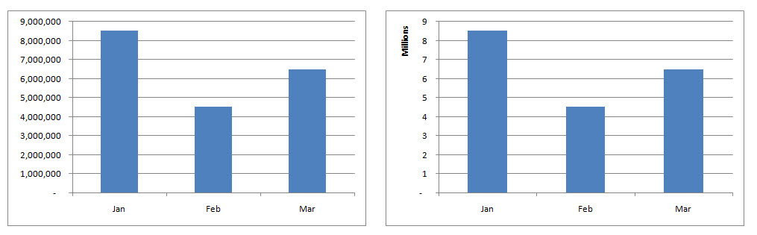
Axes and Gridlines
Excel computes starting, ending, and incremental values for display on the value axis
A gridline is a horizontal or vertical line through the plot area
Notes:
By default, Excel will compute markers for the starting, ending, and incremental values on the Y (value) axis. To change settings, click Axes in the Axes group and point to Primary Vertical Axis. Select from options to change units or select More Primary Vertical Axis Options to customize the markers.
Gridlines are horizontal or vertical lines that span the chart to help people identify the values plotted by the visual elements. To change settings, click Gridlines in the Axes group, and point to either Primary Horizontal Gridlines or Primary Vertical Gridlines. Select from options to remove gridlines or add Minor Gridlines for more detail on the chart.
Figure 3.44 displays two charts—one with the original intervals and the other in millions.

